Slide 1
20231220_analysis SLC families with On-the-Fly Modeling tool
SLC families retrieved from: https://re-solute.eu/knowledgebase/gene

Slide 2
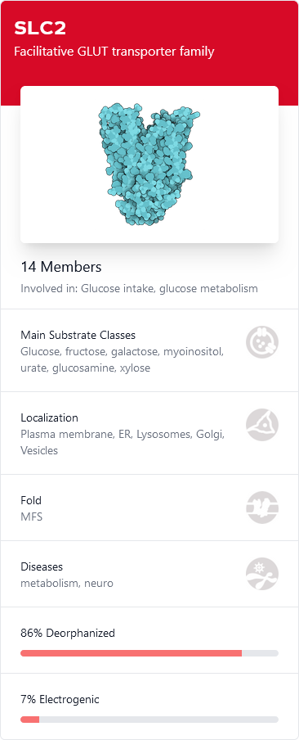
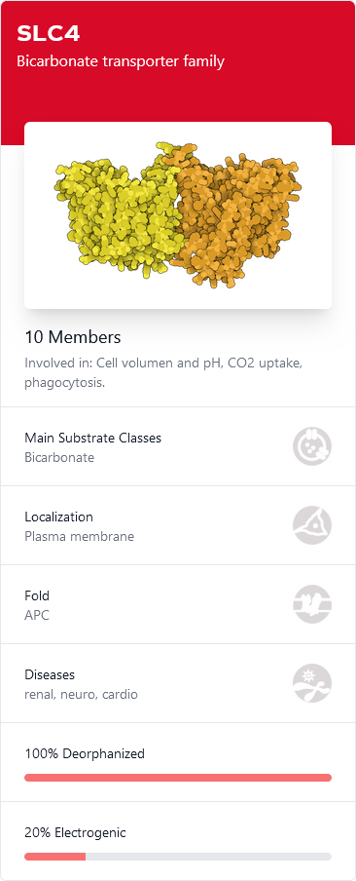
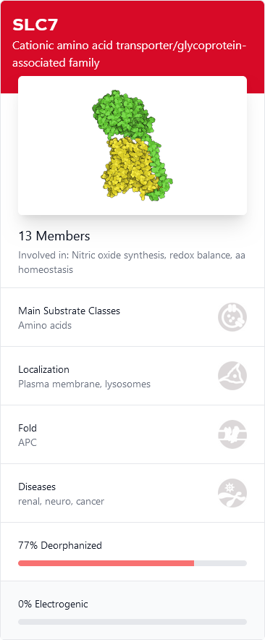
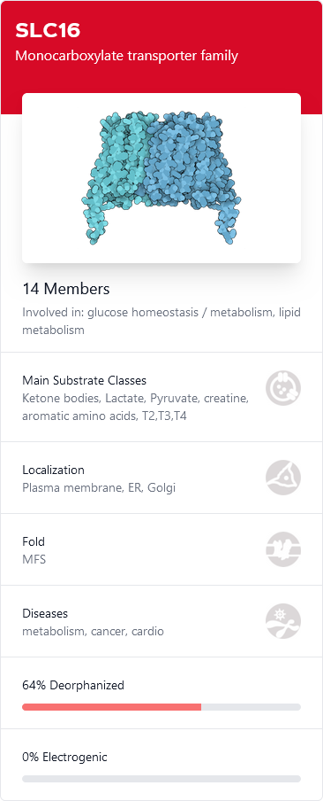
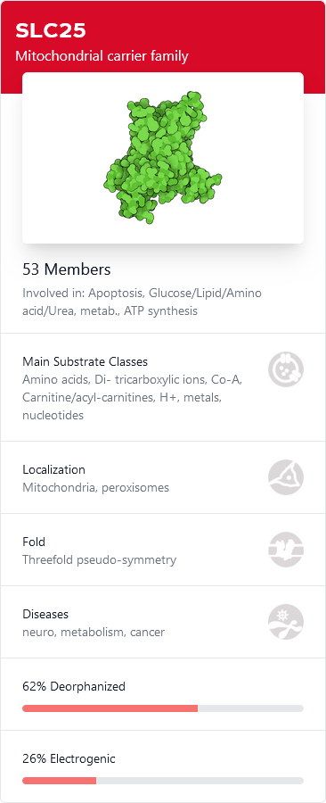
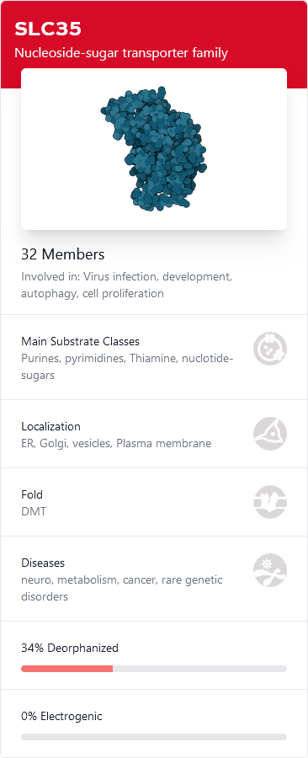
Promising SLC families:
SLC families with more than one family member in Ligand Discovery dataset and enough data to calculate AUROC.
Labeled with blue highlighted headline in the following slides.

Slide 3
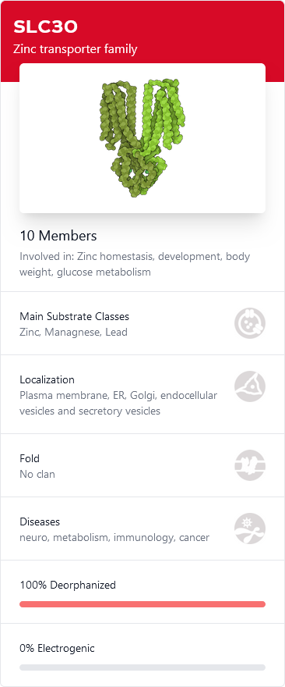
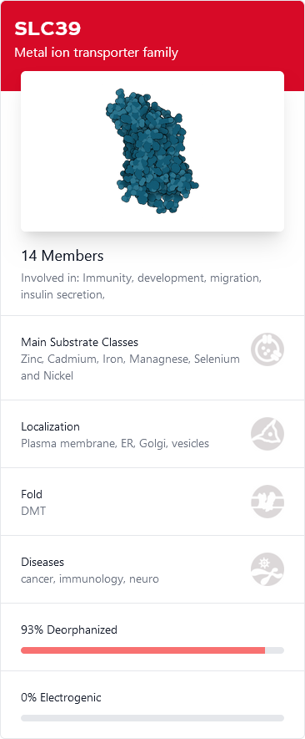
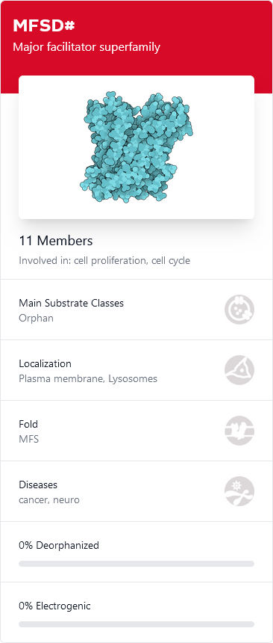
Promising families (however metal transporters or substrate unknown):
SLC families with more than one family member in Ligand Discovery dataset and enough data to calculate AUROC.
Labeled with blue highlighted headline in the following slides.

Slide 4
SLC1A1
SLC1A2
SLC1A3
SLC1A4
SLC1A5
SLC1A6
SLC1A7
None of your input proteins was found in the Ligand Discovery Interactome.

Slide 5
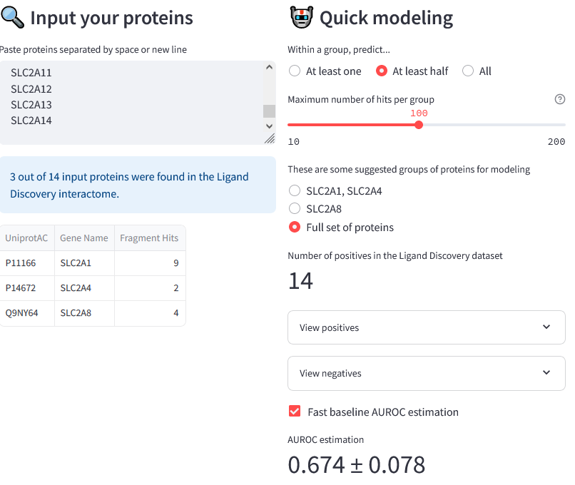
SLC2 family
SLC2A1
SLC2A2
SLC2A3
SLC2A4
SLC2A5
SLC2A6
SLC2A7
SLC2A8
SLC2A9
SLC2A10
SLC2A11
SLC2A12
SLC2A13
SLC2A14

Slide 6
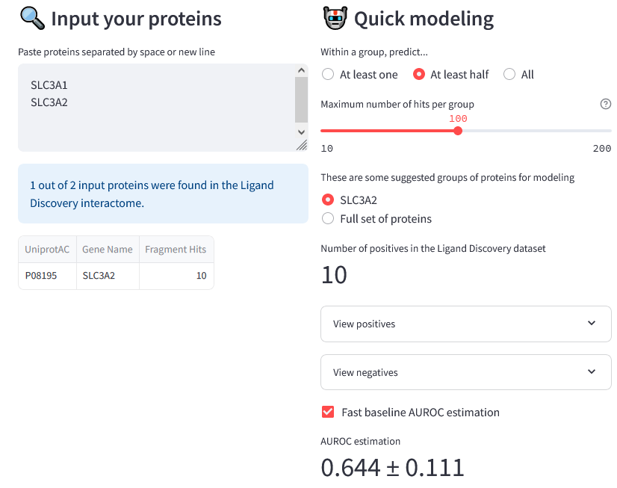
SLC3A1
SLC3A2

Slide 7
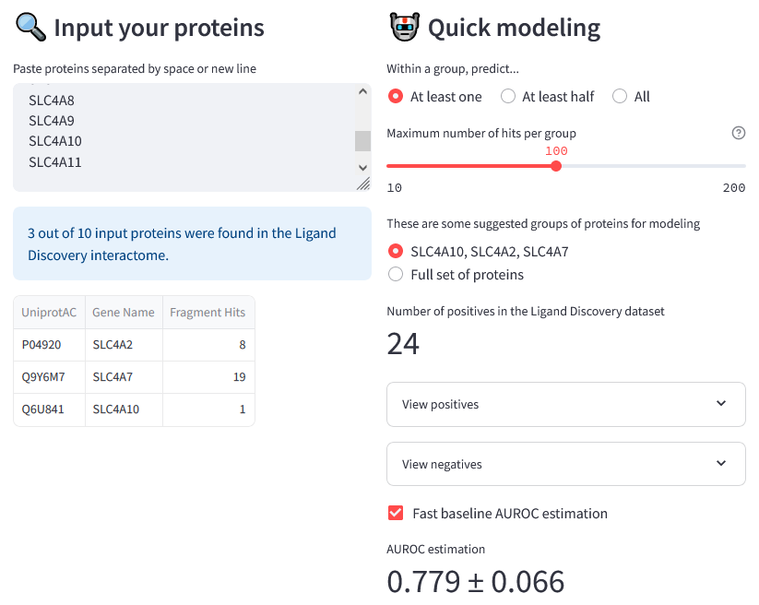
SLC4 family
SLC4A1
SLC4A2
SLC4A3
SLC4A4
SLC4A5
SLC4A7
SLC4A8
SLC4A9
SLC4A10
SLC4A11

Slide 8
SLC5A1
SLC5A2
SLC5A3
SLC5A4
SLC5A5
SLC5A6
SLC5A7
SLC5A8
SLC5A9
SLC5A10
SLC5A11
SLC5A12
None of your input proteins was found in the Ligand Discovery Interactome.

Slide 9
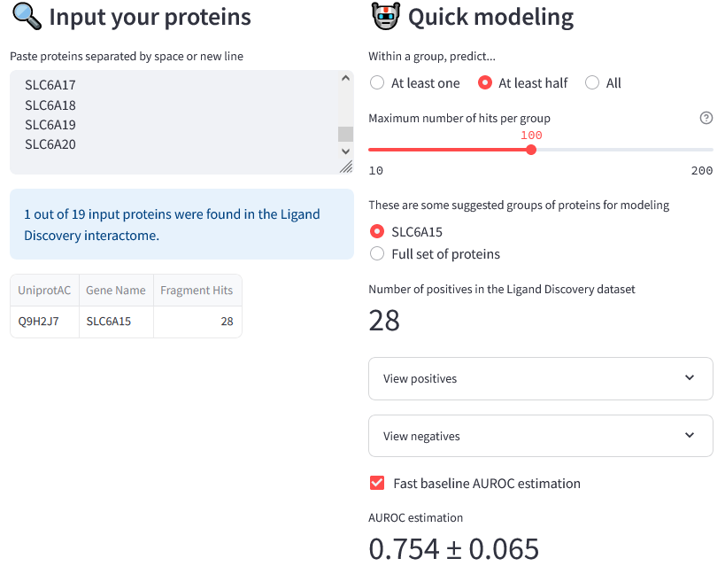
SLC6A1
SLC6A2
SLC6A3
SLC6A4
SLC6A5
SLC6A6
SLC6A7
SLC6A8
SLC6A9
SLC6A11
SLC6A12
SLC6A13
SLC6A14
SLC6A15
SLC6A16
SLC6A17
SLC6A18
SLC6A19
SLC6A20

Slide 10
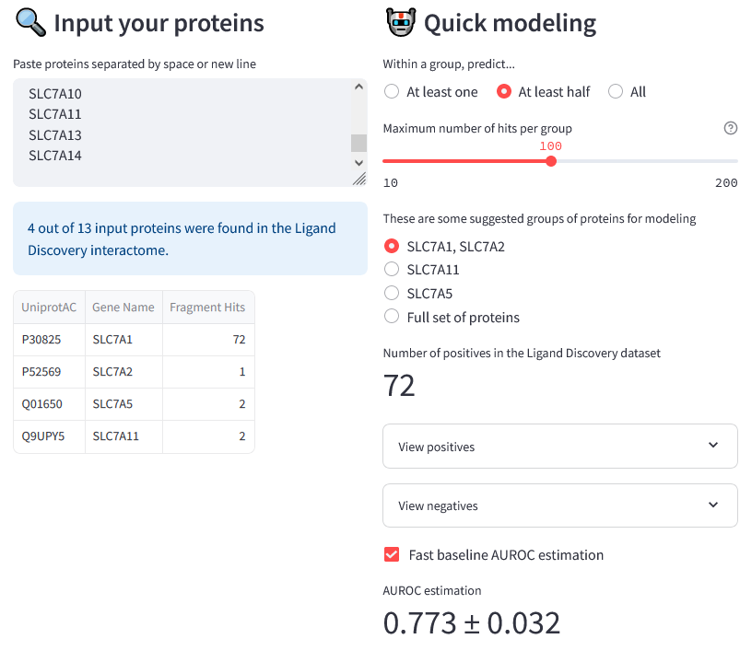
SLC7 family
SLC7A1
SLC7A2
SLC7A3
SLC7A4
SLC7A5
SLC7A6
SLC7A7
SLC7A8
SLC7A9
SLC7A10
SLC7A11
SLC7A13
SLC7A14

Slide 11
SLC8A1
SLC8A2
SLC8A3
SLC8B1
None of your input proteins was found in the Ligand Discovery Interactome.

Slide 12
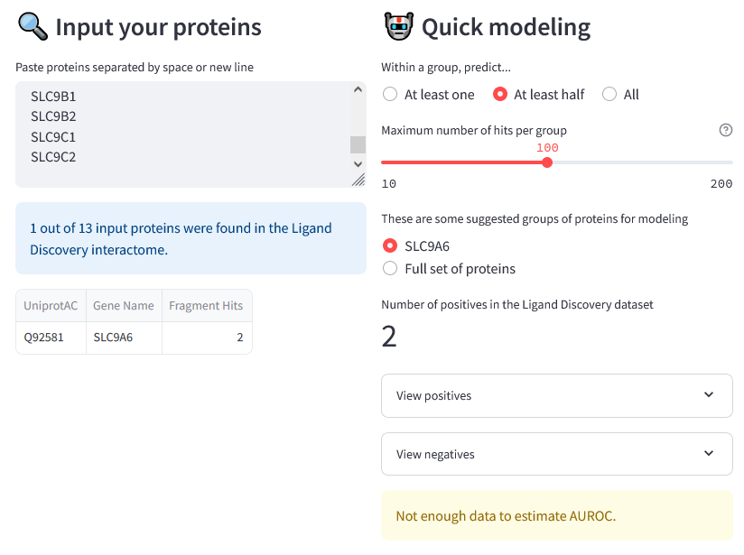
SLC9A1
SLC9A2
SLC9A3
SLC9A4
SLC9A5
SLC9A6
SLC9A7
SLC9A8
SLC9A9
SLC9B1
SLC9B2
SLC9C1
SLC9C2

Slide 13
SLC10A1
SLC10A2
SLC10A3
SLC10A4
SLC10A5
SLC10A6
SLC10A7
None of your input proteins was found in the Ligand Discovery Interactome.

Slide 14
SLC11A1
SLC11A2
None of your input proteins was found in the Ligand Discovery Interactome.

Slide 15
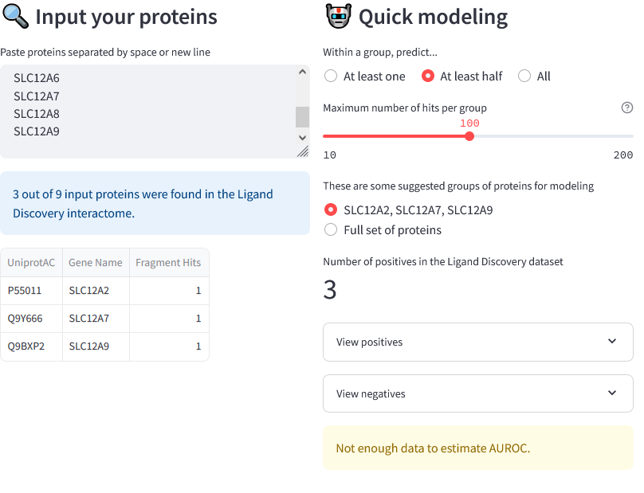
SLC12A1
SLC12A2
SLC12A3
SLC12A4
SLC12A5
SLC12A6
SLC12A7
SLC12A8
SLC12A9

Slide 16
SLC13A1
SLC13A2
SLC13A3
SLC13A4
SLC13A5
None of your input proteins was found in the Ligand Discovery Interactome.

Slide 17
SLC14A1
SLC14A2
None of your input proteins was found in the Ligand Discovery Interactome.

Slide 18
SLC15A1
SLC15A2
SLC15A3
SLC15A4
SLC15A5
None of your input proteins was found in the Ligand Discovery Interactome.

Slide 19
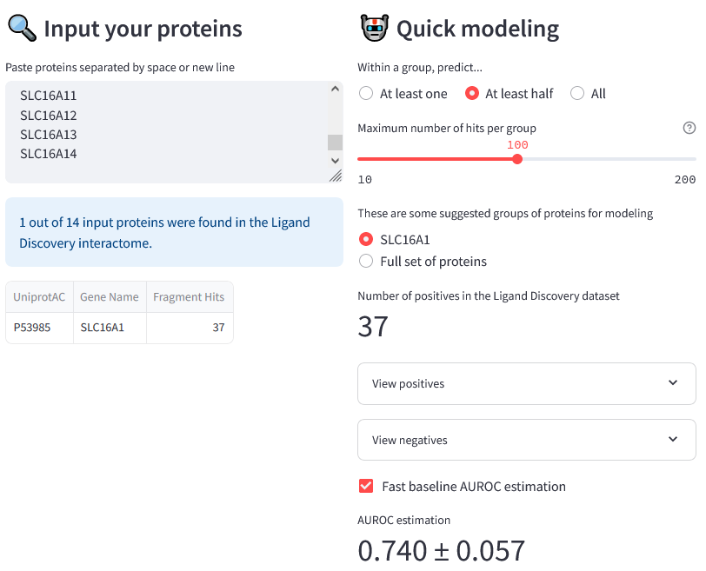
SLC16 family
SLC16A1
SLC16A2
SLC16A3
SLC16A4
SLC16A5
SLC16A6
SLC16A7
SLC16A8
SLC16A9
SLC16A10
SLC16A11
SLC16A12
SLC16A13
SLC16A14

Slide 20
SLC17A1
SLC17A2
SLC17A3
SLC17A4
SLC17A5
SLC17A6
SLC17A7
SLC17A8
SLC17A9
None of your input proteins was found in the Ligand Discovery Interactome.

Slide 21
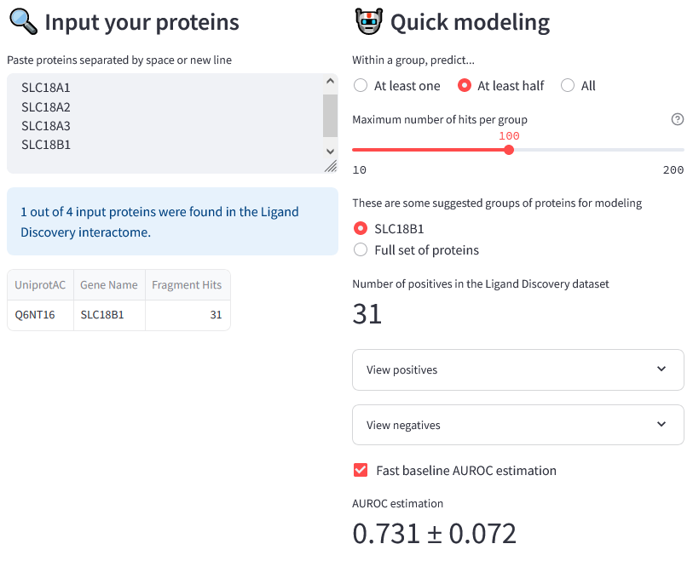
SLC18A1
SLC18A2
SLC18A3
SLC18B1

Slide 22
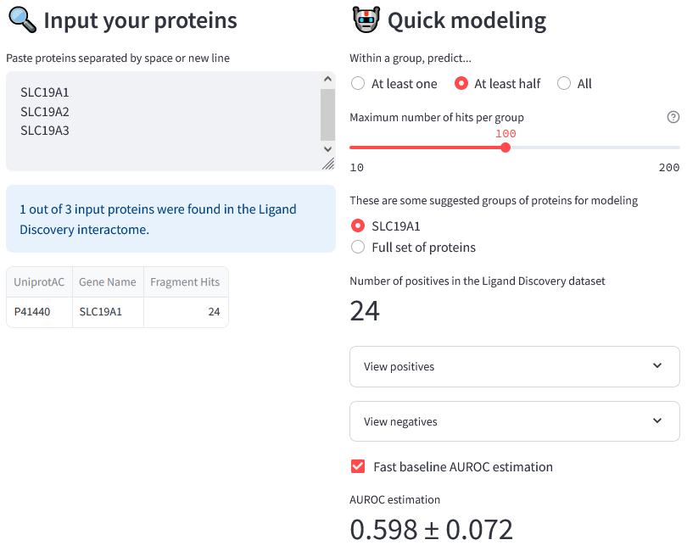
SLC19A1
SLC19A2
SLC19A3

Slide 23
SLC20A1
SLC20A2
None of your input proteins was found in the Ligand Discovery Interactome.

Slide 24
SLCO1A2
SLCO1B1
SLCO1B3
SLCO1B7
SLCO1C1
SLCO2A1
SLCO2B1
SLCO3A1
SLCO4A1
SLCO4C1
SLCO5A1
SLCO6A1
None of your input proteins was found in the Ligand Discovery Interactome.

Slide 25
SLC22A1
SLC22A2
SLC22A3
SLC22A4
SLC22A5
SLC22A6
SLC22A7
SLC22A8
SLC22A9
SLC22A10
SLC22A11
SLC22A12
SLC22A13
SLC22A14
SLC22A15
SLC22A16
SLC22A17
SLC22A18
SLC22A23
SLC22A24
SLC22A25
SLC22A31
None of your input proteins was found in the Ligand Discovery Interactome.

Slide 26
SLC23A1
SLC23A2
SLC23A3
None of your input proteins was found in the Ligand Discovery Interactome.

Slide 27
SLC24A1
SLC24A2
SLC24A3
SLC24A4
SLC24A5
None of your input proteins was found in the Ligand Discovery Interactome.

Slide 28
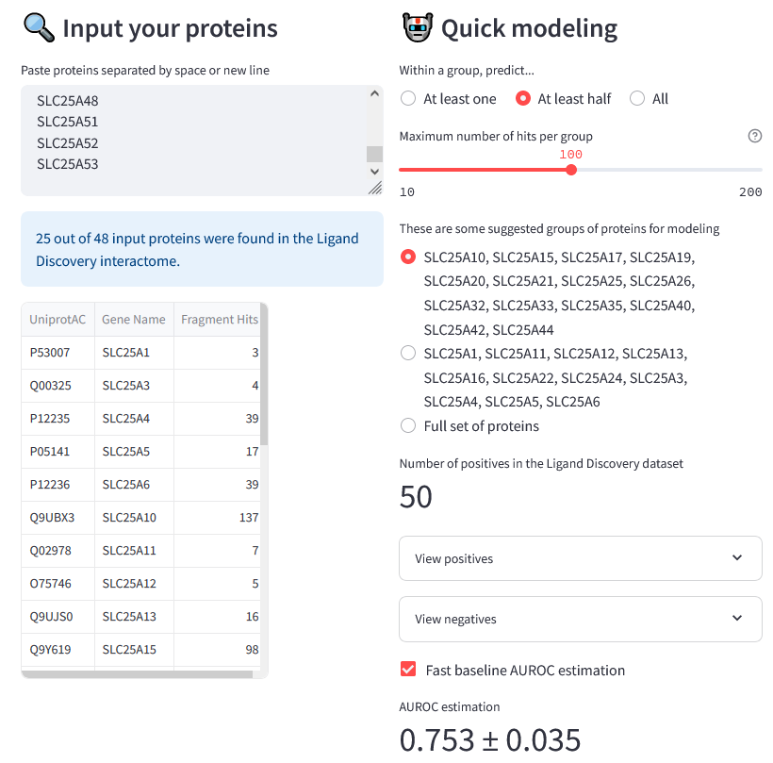
SLC25 family
SLC25A1
SLC25A2
SLC25A3
SLC25A4
SLC25A5
SLC25A6
SLC25A10
SLC25A11
SLC25A12
SLC25A13
SLC25A14
SLC25A15
SLC25A16
SLC25A17
SLC25A18
SLC25A19
SLC25A20
SLC25A21
SLC25A22
SLC25A23
SLC25A24
SLC25A25
SLC25A26
SLC25A27
SLC25A28
SLC25A29
SLC25A30
SLC25A31
SLC25A32
SLC25A33
SLC25A34
SLC25A35
SLC25A36
SLC25A37
SLC25A38
SLC25A39
SLC25A40
SLC25A41
SLC25A42
SLC25A43
SLC25A44
SLC25A45
SLC25A46
SLC25A47
SLC25A48
SLC25A51
SLC25A52
SLC25A53

Slide 29
SLC26A1
SLC26A2
SLC26A3
SLC26A4
SLC26A5
SLC26A6
SLC26A7
SLC26A8
SLC26A9
SLC26A10
SLC26A11
None of your input proteins was found in the Ligand Discovery Interactome.

Slide 30
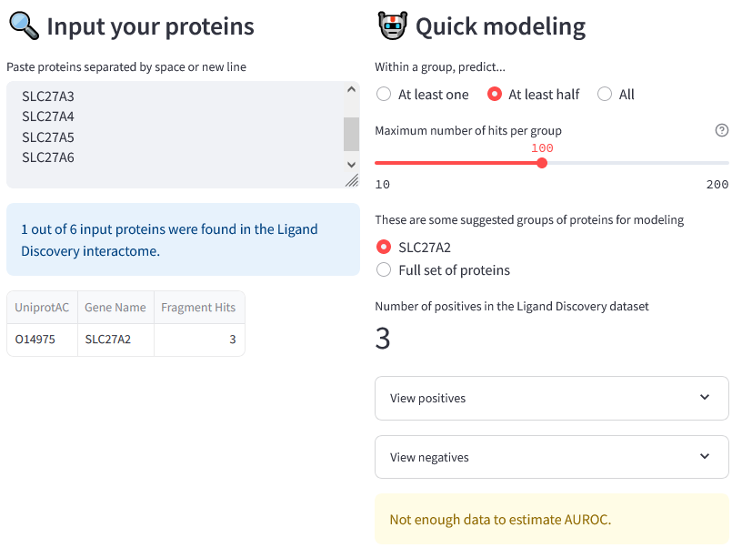
SLC27A1
SLC27A2
SLC27A3
SLC27A4
SLC27A5
SLC27A6

Slide 31
SLC28A1
SLC28A2
SLC28A3
None of your input proteins was found in the Ligand Discovery Interactome.

Slide 32
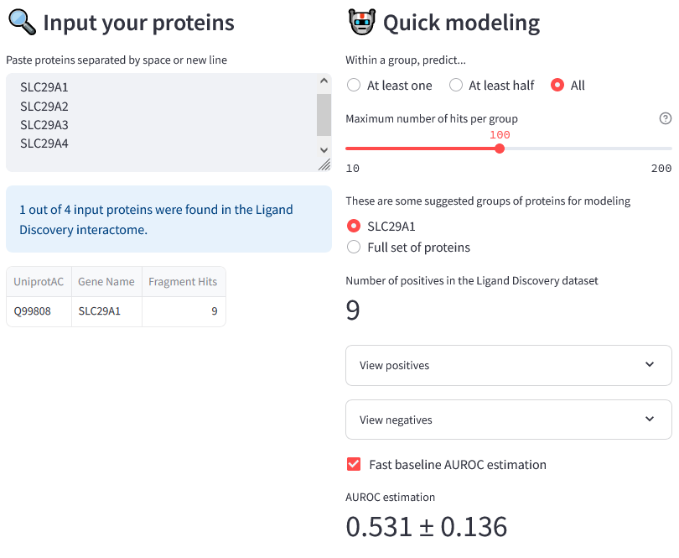
SLC29A1
SLC29A2
SLC29A3
SLC29A4

Slide 33
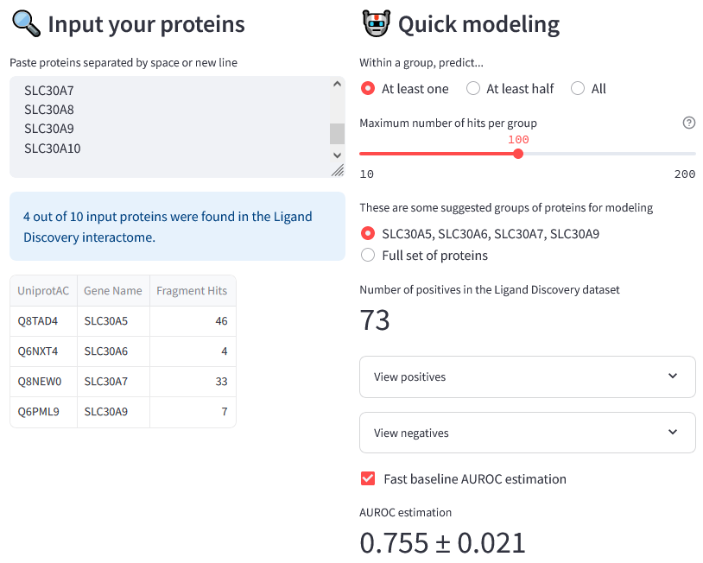
SLC30 family
SLC30A1
SLC30A2
SLC30A3
SLC30A4
SLC30A5
SLC30A6
SLC30A7
SLC30A8
SLC30A9
SLC30A10

Slide 34
SLC31A1
SLC31A2
None of your input proteins was found in the Ligand Discovery Interactome.

Slide 35
SLC32A1
None of your input proteins was found in the Ligand Discovery Interactome.

Slide 36
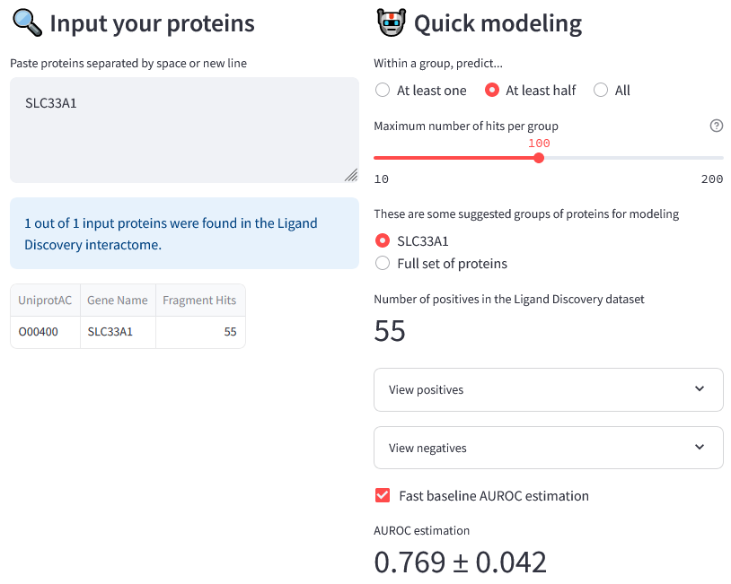
SLC33A1

Slide 37
SLC34A1
SLC34A2
SLC34A3
None of your input proteins was found in the Ligand Discovery Interactome.

Slide 38
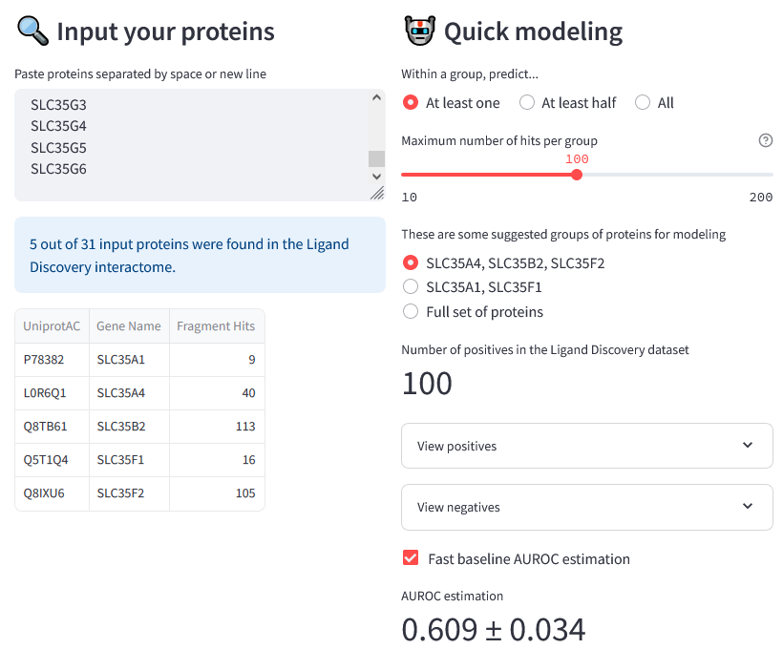
SLC35 family
SLC35A1
SLC35A2
SLC35A3
SLC35A4
SLC35A5
SLC35B1
SLC35B2
SLC35B3
SLC35B4
SLC35C1
SLC35C2
SLC35D1
SLC35D2
SLC35D3
SLC35E1
SLC35E2A
SLC35E2B
SLC35E3
SLC35E4
SLC35F1
SLC35F2
SLC35F3
SLC35F4
SLC35F5
SLC35F6
SLC35G1
SLC35G2
SLC35G3
SLC35G4
SLC35G5
SLC35G6

Slide 39
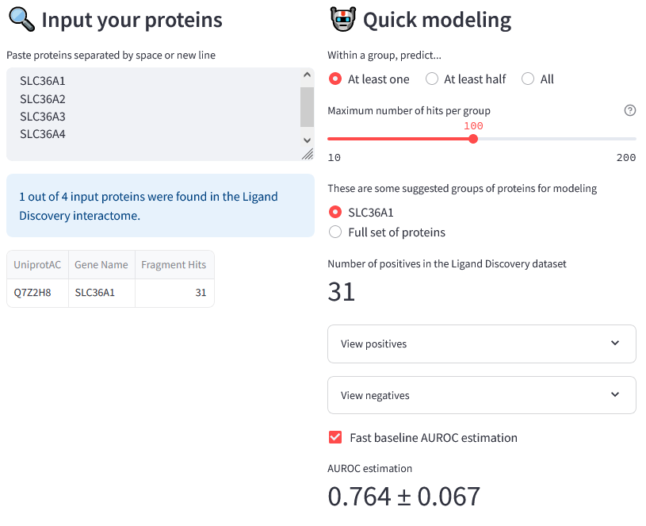
SLC36A1
SLC36A2
SLC36A3
SLC36A4

Slide 40
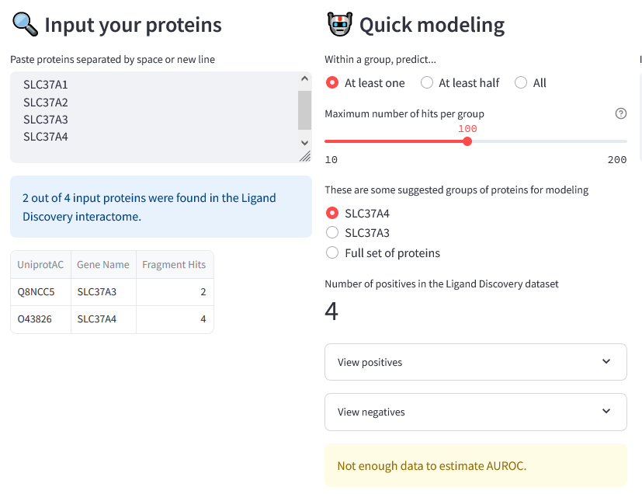
SLC37A1
SLC37A2
SLC37A3
SLC37A4

Slide 41
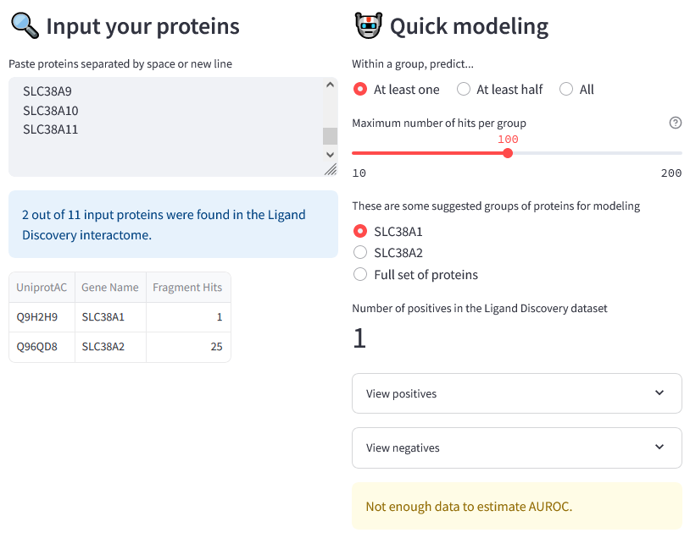
SLC38A1
SLC38A2
SLC38A3
SLC38A4
SLC38A5
SLC38A6
SLC38A7
SLC38A8
SLC38A9
SLC38A10
SLC38A11

Slide 42
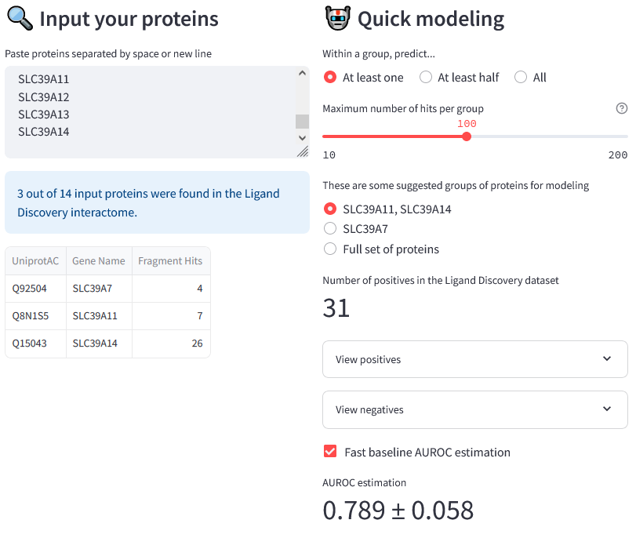
SLC39 family
SLC39A1
SLC39A2
SLC39A3
SLC39A4
SLC39A5
SLC39A6
SLC39A7
SLC39A8
SLC39A9
SLC39A10
SLC39A11
SLC39A12
SLC39A13
SLC39A14

Slide 43
SLC40A1
None of your input proteins was found in the Ligand Discovery Interactome.

Slide 44
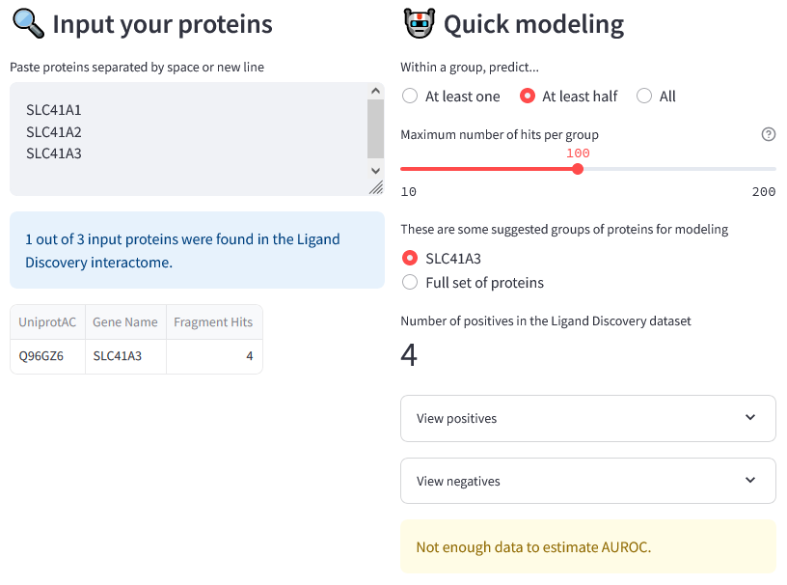
SLC41A1
SLC41A2
SLC41A3

Slide 45
SLC43A1
SLC43A2
SLC43A3
None of your input proteins was found in the Ligand Discovery Interactome.

Slide 46
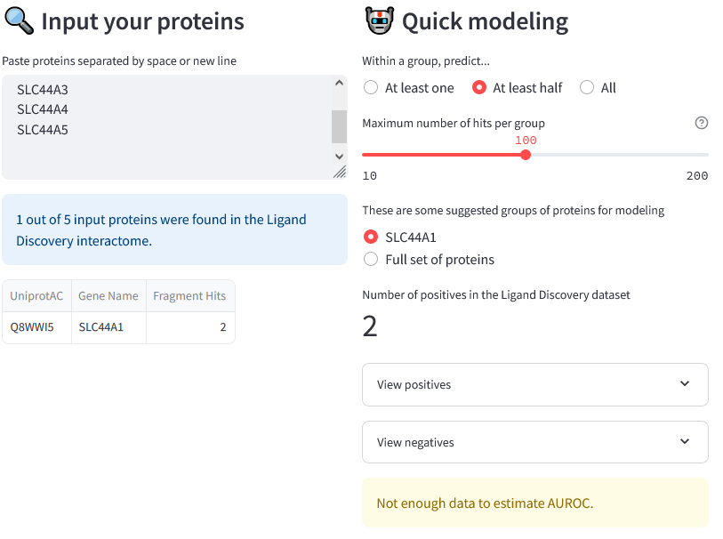
SLC44A1
SLC44A2
SLC44A3
SLC44A4
SLC44A5

Slide 47
SLC45A1
SLC45A2
SLC45A3
SLC45A4
None of your input proteins was found in the Ligand Discovery Interactome.

Slide 48
SLC46A1
SLC46A2
SLC46A3
None of your input proteins was found in the Ligand Discovery Interactome.

Slide 49
SLC47A1
SLC47A2
None of your input proteins was found in the Ligand Discovery Interactome.

Slide 50
SLC49A3
SLC49A4
None of your input proteins was found in the Ligand Discovery Interactome.

Slide 51
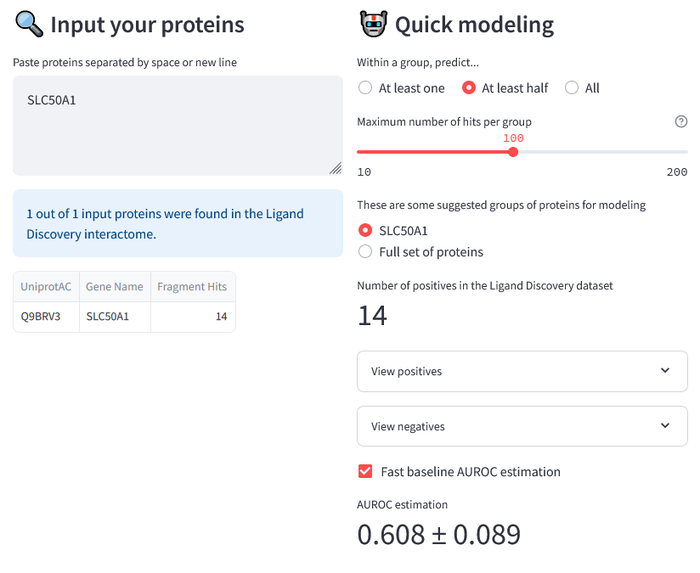
SLC50A1

Slide 52
SLC51A
SLC51B
None of your input proteins was found in the Ligand Discovery Interactome.

Slide 53
SLC52A1
SLC52A2
SLC52A3
None of your input proteins was found in the Ligand Discovery Interactome.

Slide 54
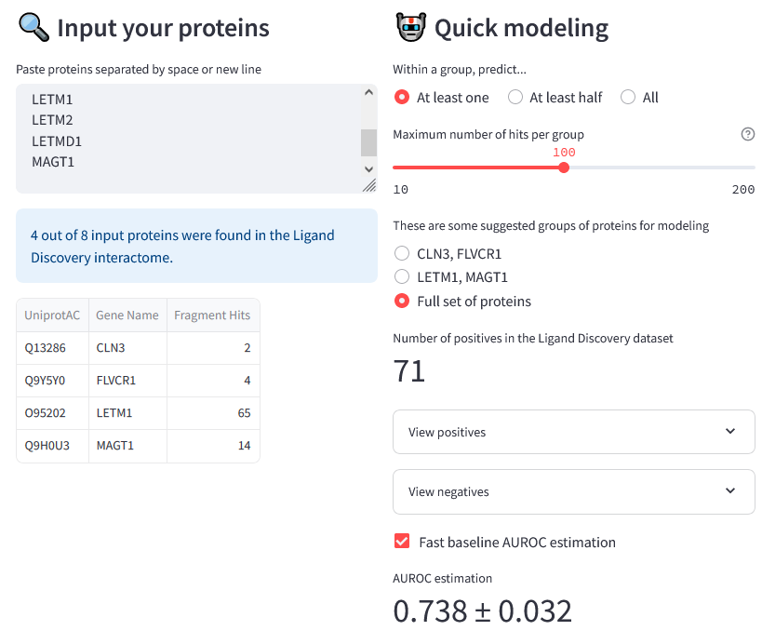
ANKH
CLN3
FLVCR1
FLVCR2
LETM1
LETM2
LETMD1
MAGT1
(rather unrelated SLCs)

Slide 55
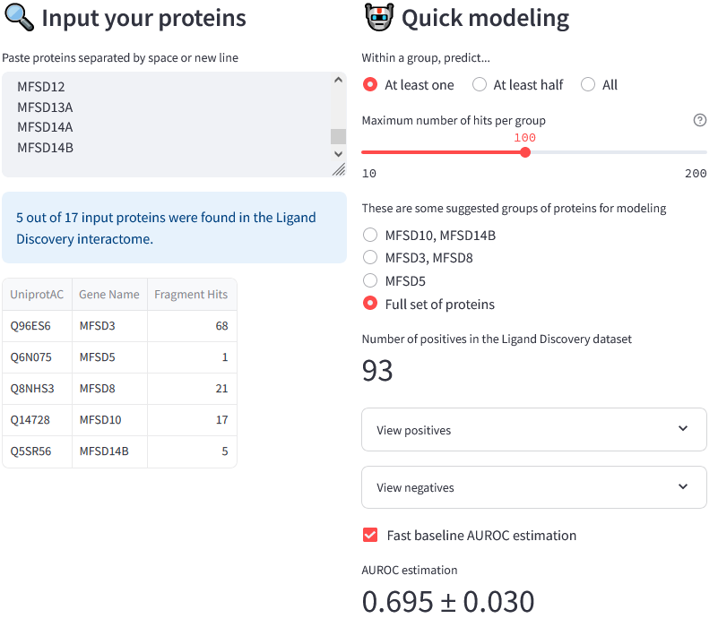
MFSD family
MFSD1
MFSD2A
MFSD2B
MFSD3
MFSD4A
MFSD4B
MFSD5
MFSD6
MFSD6L
MFSD8
MFSD9
MFSD10
MFSD11
MFSD12
MFSD13A
MFSD14A
MFSD14B

Slide 56
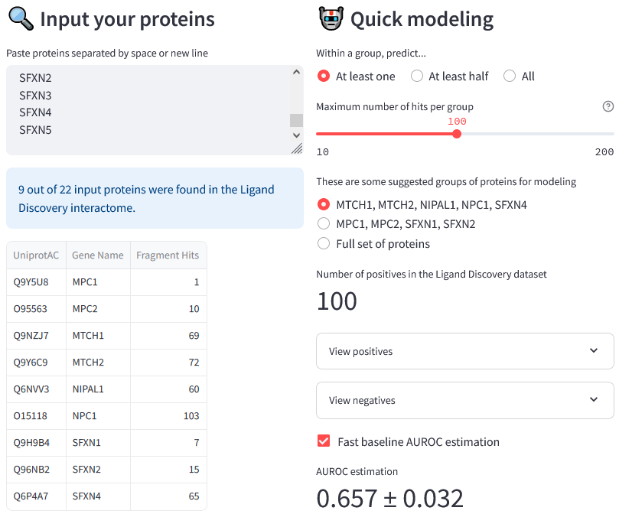
MPC1
MPC1L
MPC2
MTCH1
MTCH2
NIPA1
NIPA2
NIPAL1
NIPAL2
NIPAL3
NIPAL4
NPC1
NPC1L1
OCA2
RHAG
RHBG
RHCG
SFXN1
SFXN2
SFXN3
SFXN4
SFXN5
(unrelated SLCs, not categorized to a family)

Slide 57
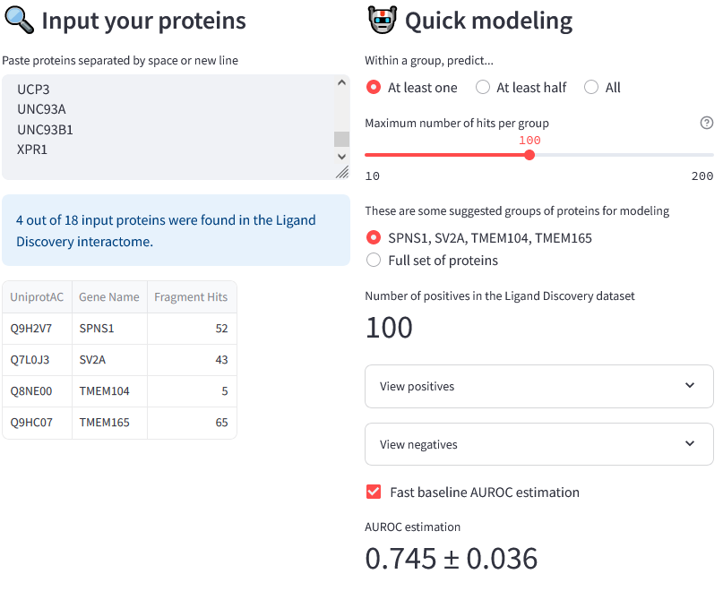
SPNS1
SPNS2
SPNS3
SV2A
SV2B
SV2C
SVOP
SVOPL
TMEM104
TMEM165
TMEM241
TUSC3
UCP1
UCP2
UCP3
UNC93A
UNC93B1
XPR1
(unrelated SLCs, not categorized to a family)

Slide 59
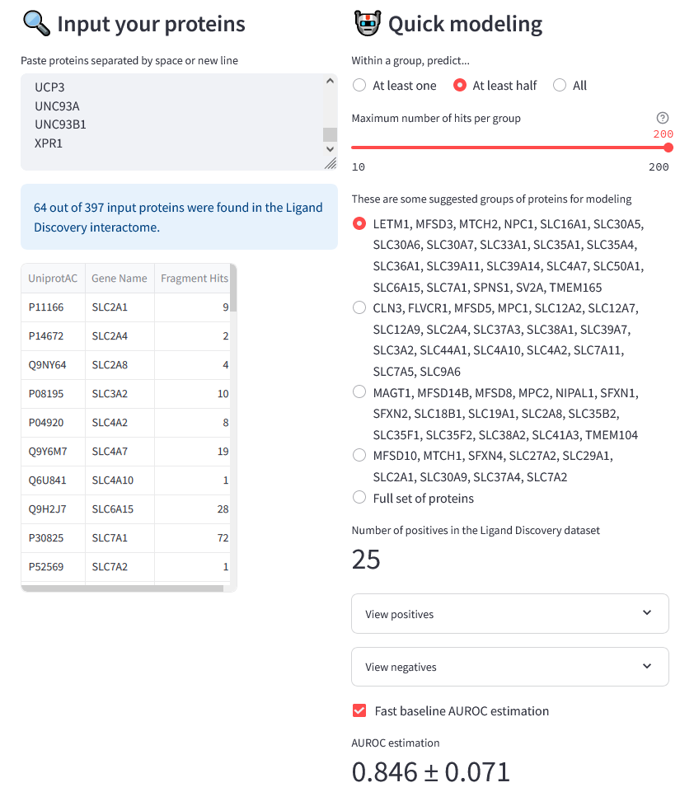
All SLCs without SLC25 family

